Slide 1

introduction,
searching,
insertion and
deletion

Slide 2
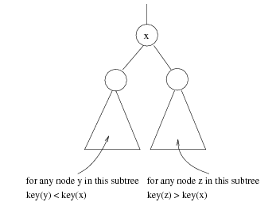
Binary Search Trees (BST)
A data structure for efficient searching, insertion and deletion
Binary search tree property
  For every node X
  All the keys in its left
  subtree are smaller than
  the key value in X
  All the keys in its right
  subtree are larger than the
  key value in X

Slide 3

Binary Search Trees
A binary search tree
Not a binary search tree

Slide 4

Binary Search Trees
The same set of keys may have different BSTs
Average depth of a node is O(log N)
Maximum depth of a node is O(N)

Slide 5
Create BST for following:
43, 10, 79, 90, 12, 10,54, 11, 9, 50

Slide 6
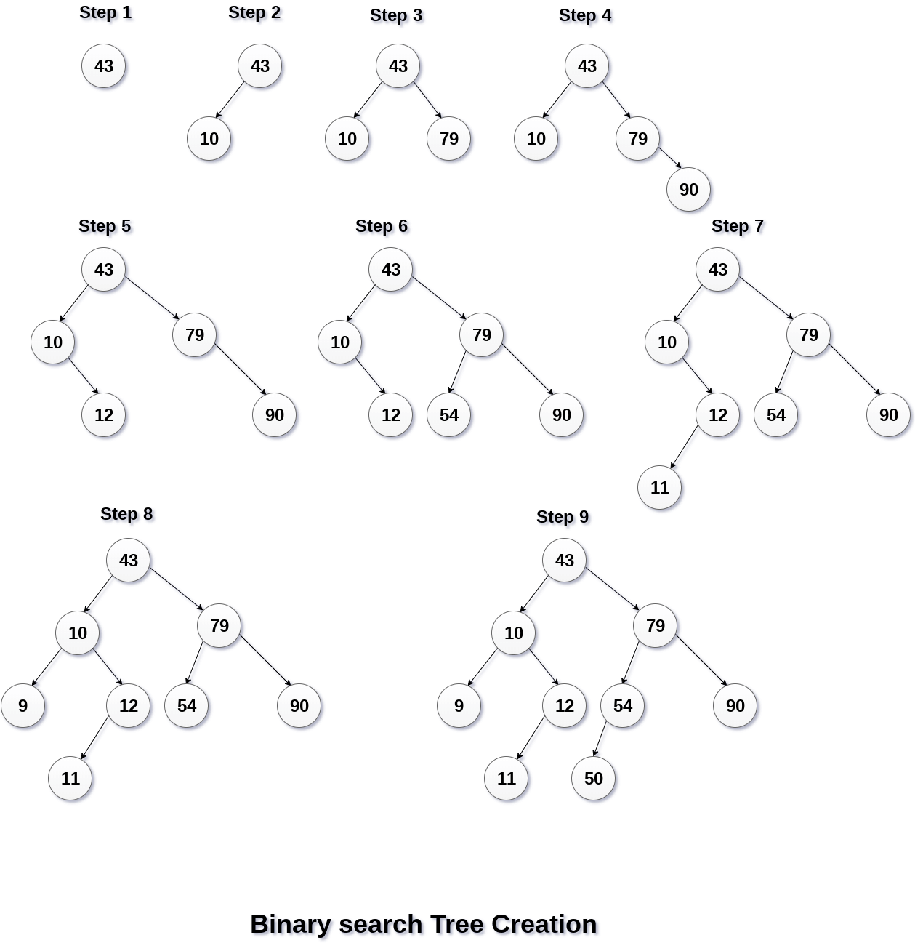

Notes:
Inorder: 9,10,11,12,43,50,54,79,90
postOrder: 9,11,12,10,50,54,90,79,43
Preorder:43,10,9,12,11,79,54,50,90

Slide 7
CREATE BST:
45, 39, 56, 12, 34, 78, 32, 10, 89, 54, 67, 81, 68, 61,51,62

Slide 8
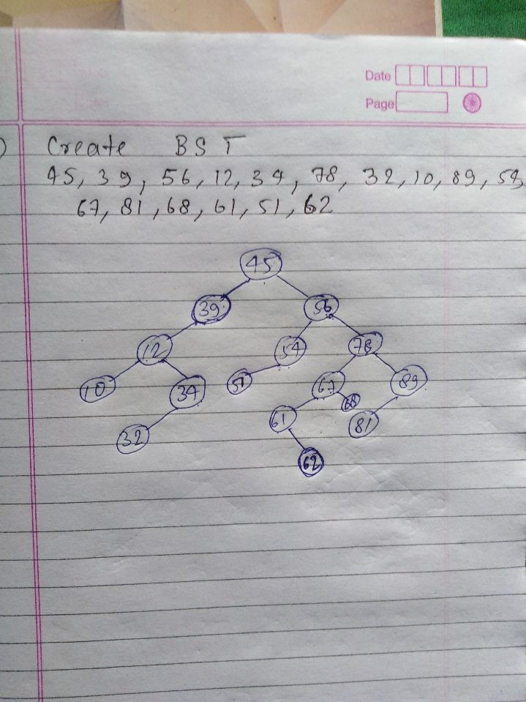
Notes:
Inorder: 10,12,32,34,39,45,51,54,56,61,62,67,68,78,81,89
PreOrder: 45,39,12,10,34,32,56,54,51,61,62,67,68,78,81,89
PostOrder: 10,32,34,12,39,51,54,62,61,68,67,81,89,78,56,45

Slide 9
Create a BST tree with following data by inserting the following elements in order of their occurrence.
200,150,350,100,70,110,250,500,400,550,450

Slide 10
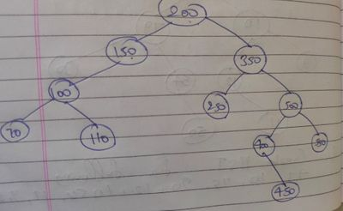

Slide 11
Create a BST tree with following data by inserting the following elements in order of their occurrence. [5 marks]
100,50,250,110,45,150,65,30,38,260,150,120,135

Slide 12
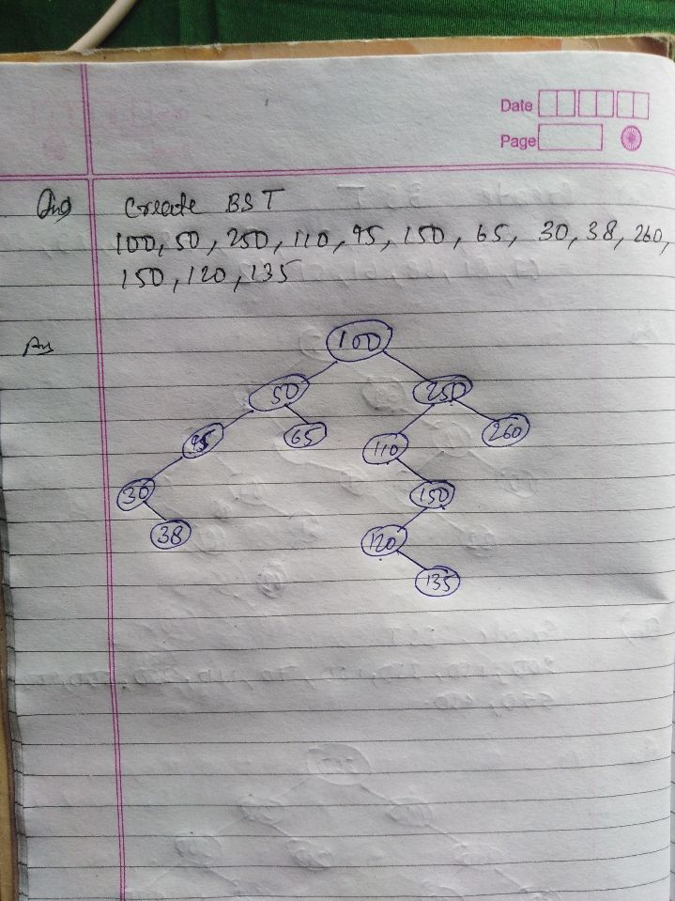

Slide 13
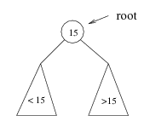
Searching BST
If we are searching for root (15), then we are done.
If we are searching for a key < root , then we should search in the left subtree.
If we are searching for a key > root, then we should search in the right subtree.

Slide 14
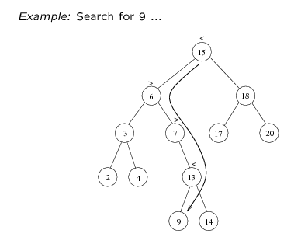
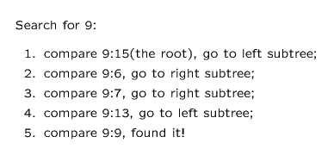

Slide 15
Searching (Find)
FIND(info, left, right, root, item, loc, par)- finds the item in tree T with root is root and info, left and right is three array represented in memory. This algorithm returns loc i.e. location of item and par i.e. parent.
[Tree Empty??]
        if root==NULL, then set LOC=NULL & PAR=NULL and return.
[Item root ??]
      If item==INFO[ROOT], then LOC=ROOT & PAR=NULL and return.
[Initialize pointer ptr and save]
      If item<INFO[ROOT]
      then set PTR = LEFT[ROOT] and SAVE=ROOT
      Else
      set PTR = RIGHT[ROOT] and SAVE=ROOT

Slide 16
      [End of if]
4. Repeat 5 and 6 while ptr!=NULL
5. [item found??]
    If ITEM=INFO[PTR], then set LOC=PTR and PAR=SAVE, and return.
6. If ITEM<INFO[PTR], then SAVE=PTR and PTR=LEFT[PTR]
  Else
  Set SAVE=PTR and PTR=RIGHT[PTR]
7. [Search unsuccessful] Set, LOC=NULL and PAR = SAVE
8. Exit
Time complexity: O(height of the tree)

Slide 17
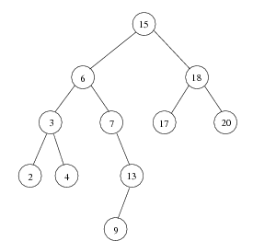
Sorting: Inorder Traversal of BST
Inorder Traversal of BST prints out all the keys in sorted order
Inorder: 2, 3, 4, 6, 7, 9, 13, 15, 17, 18, 20

Slide 18
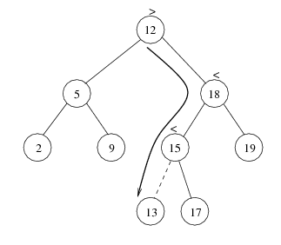
Insertion
Proceed down the tree as you would with a find
If X is found, do nothing (or update something)
Otherwise, insert X at the last spot on the path traversed
Time complexity = O(height of the tree)

Slide 19
Inserting (ADD node)
INSBST(info, left, right, root, item, loc, avail)- insert the item in tree T with root is root and info, left and right is three array represented in memory. This algorithm returns loc i.e. location of item or ADD item as new node in tree.
Call FIND(INFO, LEFT, RIGHT, ROOT, ITEM, LOC, PAR)
If LOC!=NULL, then Exit.
[Copy ITEM into new node in AVAIL list]
      If AVAIL==NULL, Print “OVER FLOW”;
      Set NEW=AVAIL, AVAIL=LEFT[AVAIL] and INFO[NEW]=ITEM.
      Set LOC=NEW,LEFT[NEW]=RIGHT[NEW]=NULL
[ADD ITEM to TREE]
  If PAR=NULL then, Set ROOT=NEW.
  Else IF ITEM<INFO[PAR] , Set LEFT[PAR]=NEW
  Else Set RIGHT[PAR]=NEW
Exit
Time complexity: O(height of the tree)

Slide 20


Deletion
When we delete a node, we need to consider how we take care of the children of the deleted node.
This has to be done such that the property of the search tree is maintained.

Slide 21
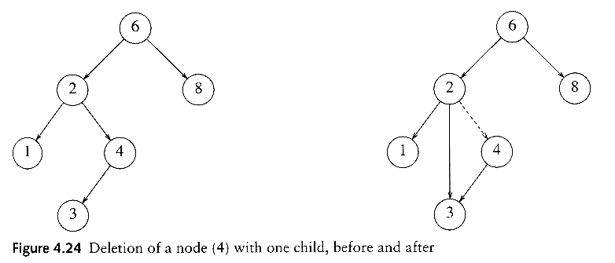
Deletion under Different Cases
Case 1: the node is a leaf
  Delete it immediately
Case 2: the node has one child
  Adjust a pointer from the parent to bypass that node

Slide 22
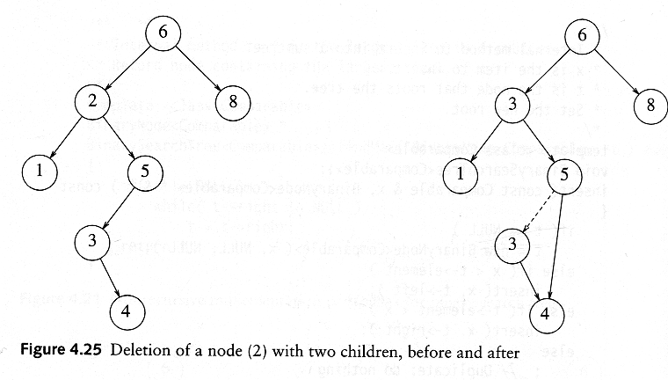
Deletion Case 3
Case 3: the node has 2 children
  Replace the key of that node with the minimum element at the right subtree
  Delete that minimum element
    Has either no child or only right child because if it has a left child, that left child would be smaller and would have been chosen. So invoke case 1 or 2.
Time complexity = O(height of the tree)

Slide 23
Deletion Algorithm
DEL(INFO, LEFT, RIGHT, ROOT, AVAIL, ITEM)
A binary search tree T is in memory, and an ITEM of information is given. This algorithm delete ITEM from the tree.
Call FIND(INFO, LEFT, RIGHT, ROOT, ITEM, LOC, PAR)
If LOC=NULL, then write ITEM not in tree and Exit
If RIGHT[LOC]!=NULL and LEFT[LOC]!=NULL, then:
Call CASEB(INFO, LEFT, RIGHT, ROOT, LOC, PAR)
Else:
Call CASEA(INFO, LEFT, RIGHT, ROOT, LOC, PAR)
Set LEFT[LOC]:=AVAIL and AVAIL :=LOC.
Exit

Slide 24
CASEA: only one or, no child
CASEA(INFO, LEFT, RIGHT, ROOT, LOC, PAR)-delete the Node N at location LOC, where N doesn’t have two Children. PAR is location of parent node or, PAR=NULL i.e. ROOT node.
[initialize CHILD]
  If LEFT[LOC]=NULL and RIGHT[LOC]=NULL, then
  CHILD=NULL
  Else if LEFT[LOC]!=NULL , then CHILD=LEFT[LOC]
  Else CHILD=RIGHT[LOC]
If PAR != NULL then: (i.e. NOT A ROOT NODE)
  If LOC=LEFT[PAR], then set LEFT[PAR]=CHILD
  Else RIGHT[PAR]=CHILD
  [End of IF]
  Else set ROOT=CHILD.
  [End of IF]
Exit

Slide 25
CASEB: has 2 children
CASEB(INFO, LEFT, RIGHT, ROOT, LOC, PAR)-delete the Node N at location LOC, where N has two Children. PAR is location of parent node or, PAR=NULL i.e. ROOT node. SUC gives location of inorder successor and PARSUC gives location of parent of inorder successor .
[Find SUC and PARSUC]
  Set PTR=RIGHT[LOC] and SAVE=LOC
  Repeat while LEFT[PTR]!=NULL
    Set, SAVE=PTR and PTR=LEFT[PTR]
    [END OF LOOP]
  Set SUC=PTR and PARSUC=SAVE.
[Delete SUC] Call CASEA(INFO, LEFT, RIGHT, ROOT, SUC,PARSUC)
[replace node N by SUC]
a) If PAR != NULL then: (i.e. NOT A ROOT NODE)
  If LOC=LEFT[PAR], then set LEFT[PAR]=SUC
  Else RIGHT[PAR]=SUC
  [End of IF]
  Else set ROOT=SUC.
  [End of IF]
  b) Set, LEFT[SUC]=LEFT[LOC] and
  RIGHT[SUC]=RIGHT[LOC]
4. Exit

Slide 26


